Slide 1


AWS Lambda

Slide 2
What is AWS Lambda?
AWS Lambda is a serverless compute service that lets you run your code without worrying about provisioning or managing any server. You can run your application or backend service using AWS Lambda with zero administration. Just upload your code on Lambda, and it will run your code, even scale the infrastructure with high availability.
The code which you run on AWS Lambda is called a lambda function. Currently, it supports the following programming languages:
Java, Python, C#, Node.js, Go, PowerShell, Ruby

Slide 3


Slide 4
AWS Lambda Features
AWS Lambda easily scales the infrastructure without any additional configuration. It reduces the operational work involved.
It offers multiple options like AWS S3, CloudWatch, DynamoDB, API Gateway, Kinesis, CodeCommit, and many more to trigger an event.
You don’t need to invest upfront. You pay only for the memory used by the lambda function and minimal cost on the number of requests hence cost-efficient.
AWS Lambda is secure. It uses AWS IAM to define all the roles and security policies.
It offers fault tolerance for both services running the code and the function. You do not have to worry about the application down.

Slide 5

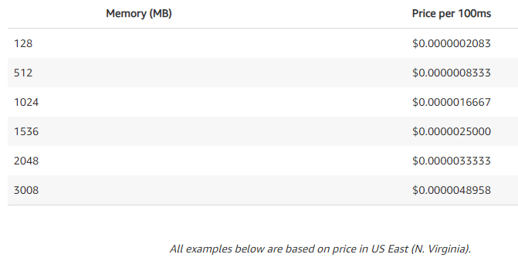
AWS Lambda Pricing
AWS Lambda pricing depends on the duration and the memory used by the lambda function written by you. The maximum you can assign is 3008 MB memory to a lambda function in 64 MB increments. Below is a pricing table with all the memory slabs for 100 milliseconds.

